Slide 1
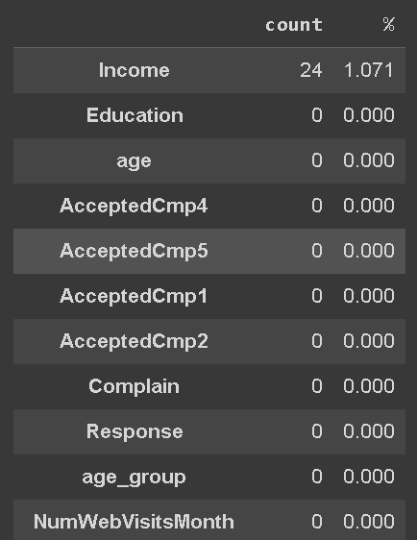
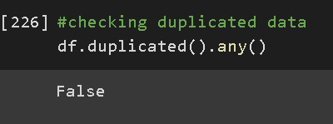
Data Cleaning & Preprocessing
There is only 1 column that has a null value, namely the income column. Because the income column is skewed, to fill in a null value, it can be imputed using the median method. As for duplicates, no duplicate data was found in this dataset, so no handling is required.
For more detail, see jupyter notebook here

Slide 2
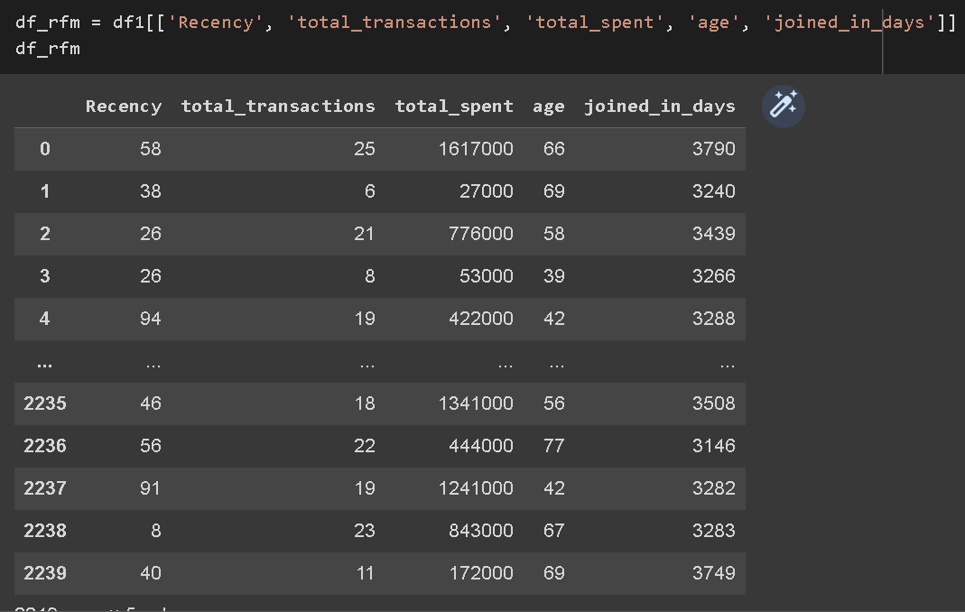
Data Cleaning & Preprocessing
In this case, we will use RFM analysis with a slight modification to help reduce the dimensionality of the data to be used as a model. By using the RFM analysis method, some of the columns used are :
- R : Recency
- F : total_transactions
- M : total_spent
Coupled with the age and joined_in_days column, so the columns that will be used when modeling are Recency, total_transactions, total_spent, age and joined_in_days. Because all the columns used are numerical, there is no need to do feature encoding
For more detail, see jupyter notebook here

Slide 3
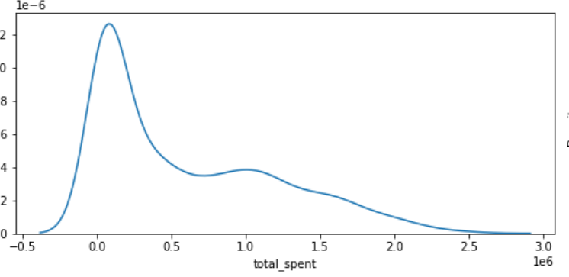
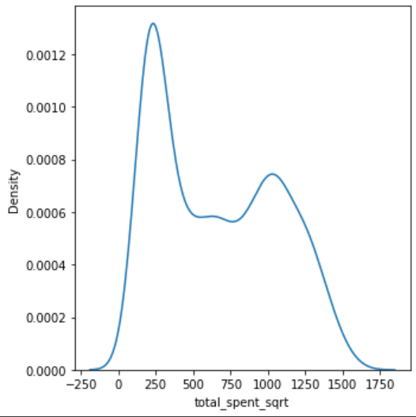
Data Cleaning & Preprocessing
because the total_spent column has a moderate skew intensity, then do a square root transformation to reduce the skewness
For more detail, see jupyter notebook here

Slide 4
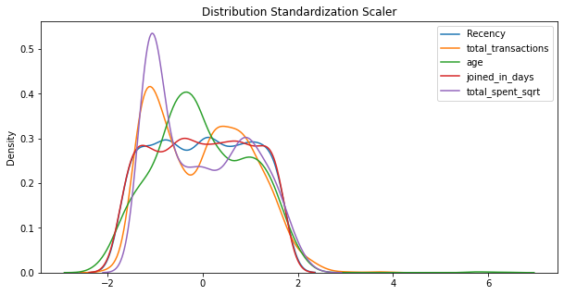
Data Cleaning & Preprocessing
Then feature standardization is performed using StandardScaler(), the image above is a visualization of data distribution after feature standardization is performed.
For more detail, see jupyter notebook here

